Slide 1
Employee Data Analysis using Excel
STUDENT NAME : YASHWANTHY.S
REGISTER NO : ACF4BDB84B0317CA0CD4567248F6BA35
(312210085)
DEPARTMENT : DEPARTMENT OF COMMERCE (B.COM)(General)
COLLEGE : VALLIAMMAL COLLEGE FOR WOMEN

Slide 2
PROJECT TITLE
Employee Performance Analysis using Excel
ANALYSIS OF FULL TIME
EMPLOYEES IN EACH ZONES

Slide 3


AGENDA
Problem Statement
Project Overview
End Users
Our Solution and Proposition
Dataset Description
Modelling Approach
Results and Discussion
Conclusion
3/21/2024 Annual Review

Slide 4

PROBLEM STATEMENT
ANALYSIS OF FULL TIME EMPLOYEES IN EACH ZONES
My analysis using Excel focuses on identifying full time employees within the organization and evaluating their performance ratings on a scale of 1 to 5. This approach allows for a deeper understanding of the potential capacity of the workforce, aiding in future strategic planning. Additionally, the analysis helps in distinguishing the capacities of male and female employees, providing insights into their contributions towards achieving the organization the organization’s goals.

Slide 5

PROJECT OVERVIEW
.
This project focuses on analysing full time employee data using Excel to assess their performance on a scale of 1 to 5. By evaluating workforce capacity and distinguishing the contributions of male and female employees, the analysis will support strategic decision making. The use of Excel ensures accurate, efficient analysis, enabling the organisation to make reliable, data-driven decisions that enhances overall performance and optimize the potential of its workforce.

Slide 6

WHO ARE THE END USERS?
HR MANAGERS: To assess employee
performance, plan training and manage talent.
SENIOR MANAGEMENT: To prepare strategic planning and decision making.
DEPARTMENT TEAMS: To evaluate team performance and allocate resources effectively.
TRAINING AND DEVELOPMENT TEAMS: To identify areas needing skill enhancement and tailor programs accordingly.
FINANCE DEPARTMENT: To link performance data with budget allocation and return on investment.
BOARD OF DIRECTORS: To review overall organizational performance and make high level decisions

Slide 7

OUR SOLUTION AND ITS VALUE PROPOSITION
FILTERING: It is generally used to remove unwanted values under this analysis we use filtering to reduce the overall data containing different departments and particularly focus on sales and production department in this analysis.
PIVOT TABLE AND GRAPH: It helps in summarizing large volume of data and converting them into particular categories. Under this analysis pivot table helps to differentiate data based on performance rating of the employees and their zone divisions along with the comparison between male and female employees.

Slide 8
Dataset Description
EMPLOYEE DATA SET: Kaggle
26 FEATURES
FEARURES USED: 6 Features were used.
1.Department type: Has seven departments in total were this analysis focuses on sales and production department in general.
2.Current Employee Rating: Ranges from 1 to 5.
3.Employee type: Has three types of employees in this analysis it focuses on full time employees.
4.Gender Code: Focuses on female and male employees.
5.Employee Classification Type: Focuses on the values of the data.
6.PayZone: Focus on three different zones under which employees are categorised.

Slide 9

THE "WOW" IN OUR SOLUTION
Excel's pivot tables facilitate the efficient organization and analysis of complex employee data, allowing for clear segmentation by zone, gender, and department. Advanced filtering and sorting features enable detailed examination of trends and patterns, while charts and graphs visually represent key insights. Additionally, Excel’s formulas and functions support precise calculations and data aggregation, enhancing the accuracy of the analysis. These tools collectively aid in informed decision-making and strategic planning for organizational growth.
3/21/2024 Annual Review
9

Slide 10
MODELLING
For this analysis I had collected data from Kaggle and organised the data collected in Excel using a pivot table. I focused specifically on the Sales and Production departments, filtering for gender codes( male and female), Employee Classification Types, and pay zones in the rows. In the columns, I arranged the current employee ratings from 1 to 5. to narrow down the data for analysis, I selected only full time employees, aiming to assess the distribution of these employees in different zones. To visualise the findings, I prepared a graph using the pivot table, ensuring all necessary details were included for a comprehensive analysis of full time employees in each zone.
10

Slide 11
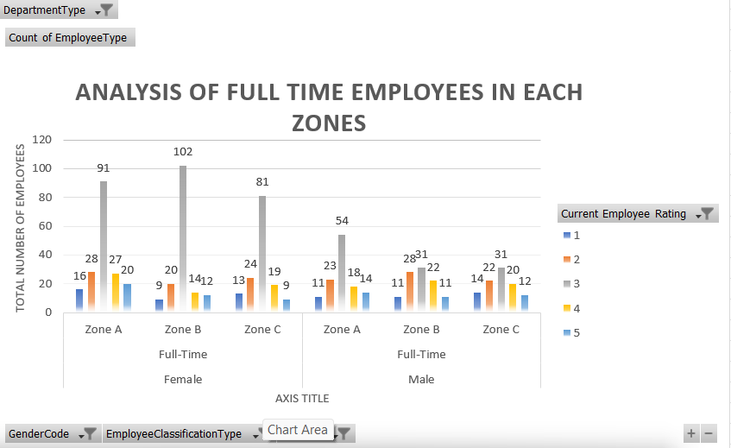
RESULTS
11

Slide 12
conclusion
In conclusion, the analysis of full-time employees in Zones A, B, and C, segmented by gender and focused on the sales and production departments, reveals valuable insights into workforce distribution and departmental performance. The pivot table data highlights distinct patterns in employee numbers, productivity, and gender representation across these zones. For both male and female workers, the analysis indicates that targeted resource allocation and strategic development initiatives can significantly enhance departmental efficiency. Leveraging these insights allows the organization to address gender imbalances, optimize departmental performance, and foster a more inclusive work environment. Ultimately, this strategic approach supports the organization’s growth and competitive advantage in the market.

